Slide 1
A minute of mindfulness

Slide 2

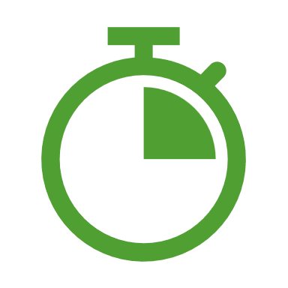


A minute you can take anywhere with you
Set your timer for one minute
Try it without the timer
A minute is all that you need
Now settle back and count how many breaths you take in that minute.
Follow your breath in and out, counting up to the number of breaths you take in a minute.
You now have a mindfulness tool you can take anywhere. Sometimes a minute is all you need to reset yourself and get on with your day.

